Slide 1
3
APPLICATIONS OF DIFFERENTIATION

Slide 2
Contents
3.1. Maximum and minimum
3.2. Mean value theorem
3.3. Derivates and the shapes of Graphs
3.5. Optimization Problems
3.6. Newton’s Method
3.7. Antiderivatives

Slide 3
APPLICATIONS OF DIFFERENTIATION
3.1
Maximum and
Minimum Values
In this section, we will learn:
How to find the maximum
and minimum values of a function.
Notes:
Intuitive and precise definitions of local and absolute extreme.
The extreme value theorem.
Critical numbers, Fermat’s theorem and the closed interval method.

Slide 4
absolute maximum → Giá trị lớn nhất → max
absolute minimum → Giá trị nhỏ nhất → min
local maximum → Cực đại địa phương → cực đại
local minimum → Cực tiểu địa phương → cực tiểu

Slide 5
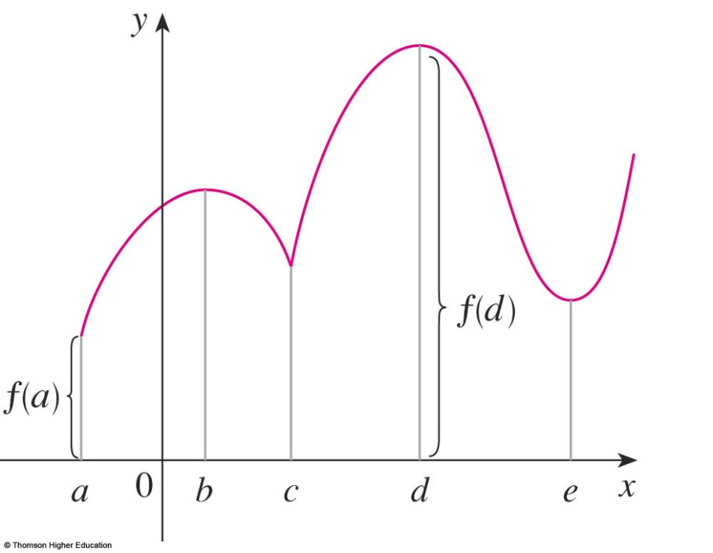
MAXIMUM & MINIMUM VALUES
Definition 1
A function f has an absolute maximum (or global maximum) at d if f(d) ≥ f(x) for all x in D, where D is the domain of f.
The number f(d) is called
the maximum value of f
on D.

Slide 6
MAXIMUM & MINIMUM VALUES
Definition 1
Similarly, f has an absolute minimum at c
if f(c) ≤ f(x) for all x in D and the number f(c)
is called the minimum value of f on D.
The maximum and minimum
values of f are called
the extreme values of f.

Slide 7
MAXIMUM & MINIMUM VALUES
Definition 2
  A function f has a local maximum (or relative maximum) at c if f(c) ≥ f(x) when x is near c.
  Similarly, f has a local minimum at c
  if f(c) ≤ f(x) when x is near c.

Slide 8
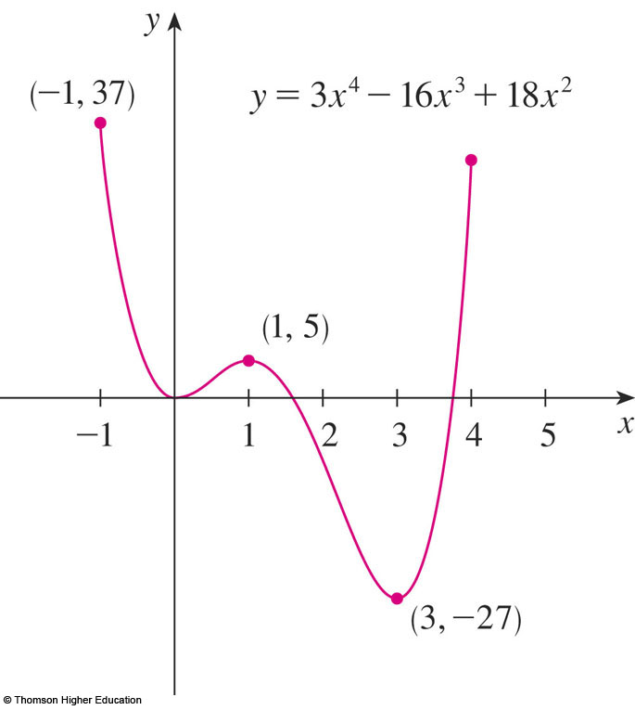
MAXIMUM & MINIMUM VALUES
Example 4
The graph of the function
f(x) = 3x⁴ – 16x³ + 18x², -1 ≤ x ≤ 4
is shown here.
f(1) = 5 is a local maximum
the absolute maximum is f(-1) = 37
f(0) = 0 is a local minimum and
f(3) = -27 is both a local
and an absolute minimum.

Slide 9
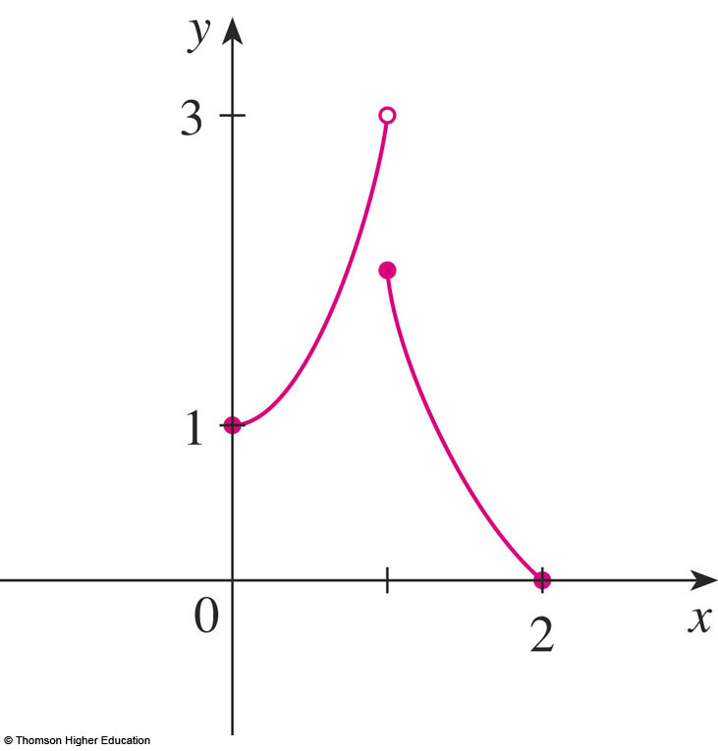
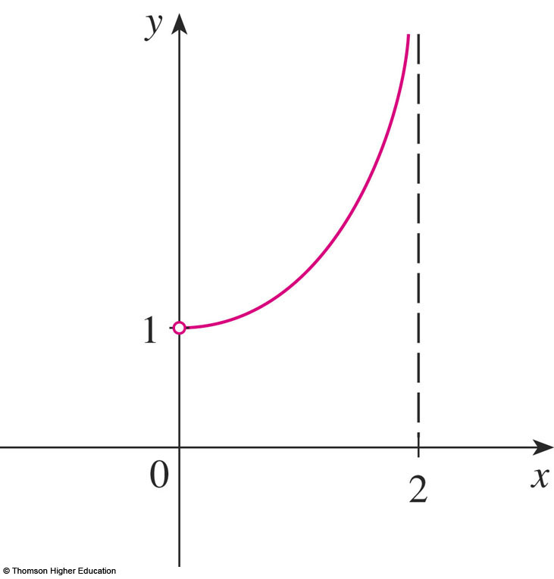
EXTREME VALUE THEOREM
In the first figure, why isn’t 3 the absolute maximum value?
In the second, does it have the absolute maximum and minimum value?

Slide 10
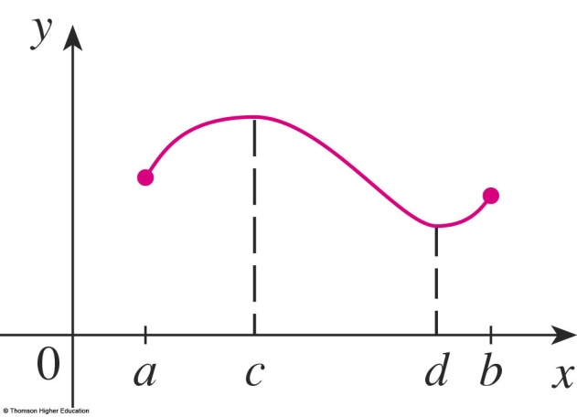
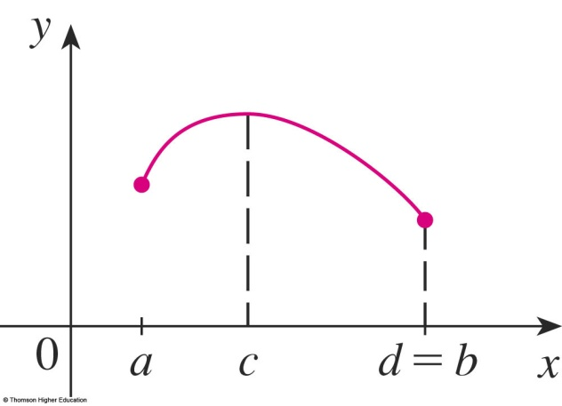
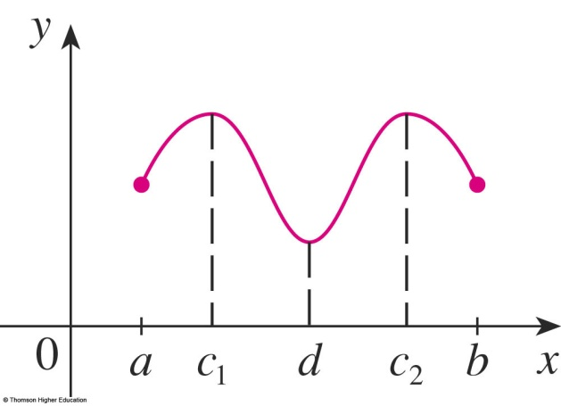
EXTREME VALUE THEOREM
Theorem 3
If f is continuous on a closed interval [a, b],
then f attains an absolute maximum value f(c)
and an absolute minimum value f(d)
at some numbers c and d in [a, b].

Slide 11
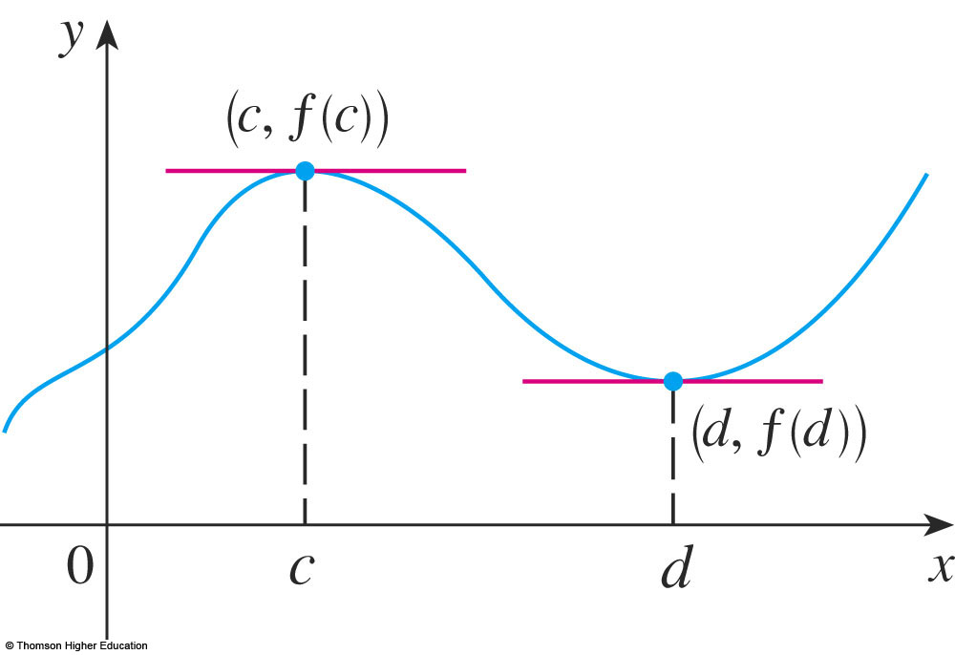
EXTREME VALUE THEOREM
The theorem does not tell us how to find these extreme values.
  We start by looking for local extreme values.

Slide 12
FERMAT’S THEOREM
Theorem 4
If f has a local maximum or minimum at c, and
if f ’(c) exists,
then f ’(c) = 0.

Slide 13
Is it true if say that
” f’(c)=0 if f has local extreme value at c?”
Answer: It is false, see next

Slide 14
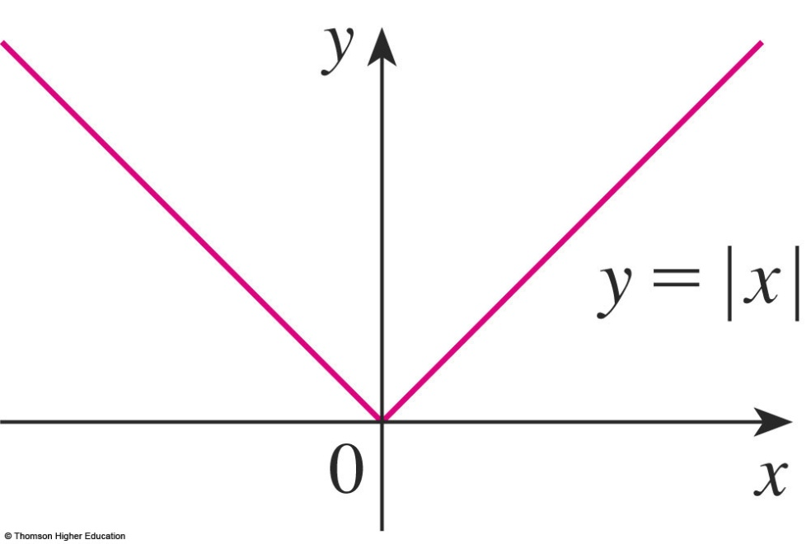
CRITICAL NUMBERS
Example
  The function f(x) = |x| has its (local and absolute) minimum value at 0.
  f ’(0) does not exist.

Slide 15
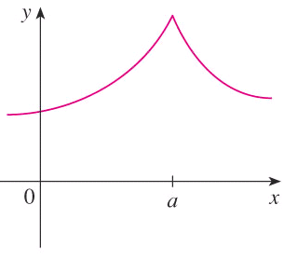

CRITICAL NUMBERS
Definition 6
A critical number (giá trị tới hạn)
of a function f is a number c in the domain of f
such that either f ’(c) = 0 or f ’(c) does not exist.

Slide 16
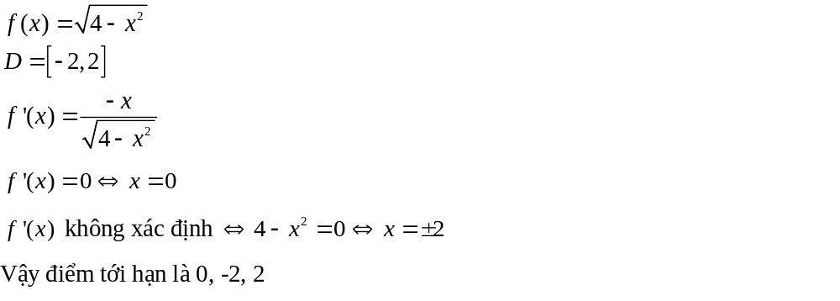

Slide 17
CRITICAL NUMBERS
Theorem 7
If f has a local maximum or minimum at c,
then c is a critical number of f.

Slide 18
CLOSED INTERVAL METHOD
To find the absolute maximum and minimum values of a continuous function f on a closed interval [a, b]:
  Find the values of f at the critical numbers of f
  in (a, b).
  Find the values of f at the endpoints of the interval.
  The largest value from 1 and 2 is the absolute maximum value. The smallest is the absolute minimum value.
Notes:
Example: find absolute extreme for the function f(x) = (x-2)/ (x² +1) on the interval.

Slide 19
Maximum-Minimum Principle 1
Suppose that f is a continuous function defined over a closed interval [a, b]. To find the absolute maximum
and minimum values over [a, b]:
a) First find f ′(x).
b) Then determine all critical values in [a, b]. That is, find all c in (a, b) for which
f ′(c) = 0 or f ′(c) does not exist.

Slide 20
Maximum-Minimum Principle 1
c) List the values from step (b) and the endpoints of the interval:
a, c₁, c₂, …., c_{n}, b.
d) Evaluate f (x) for each value in step (c):
f (a), f (c₁), f (c₂), …., f (c_{n}), f (b).
The largest of these is the absolute maximum of f over [a, b]. The smallest of these is the absolute minimum of f over [a, b].

Slide 21







Using Derivatives to Find Absolute Maximum and Minimum Values
Example 1: Find the absolute maximum and
minimum values of over the interval [–2, ].
a)
b) Note that f ′(x) exists for all real numbers.
2012 Pearson Education, Inc. All rights reserved
Slide 2.4-<number>

Slide 22










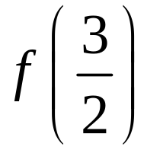
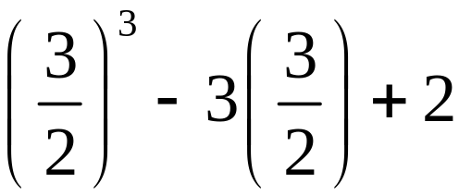

Using Derivatives to Find Absolute Maximum and Minimum Values
Example 1 (concluded):
c) –2, –1, 1,
d)
2012 Pearson Education, Inc. All rights reserved
Slide 2.4-<number>

Slide 23
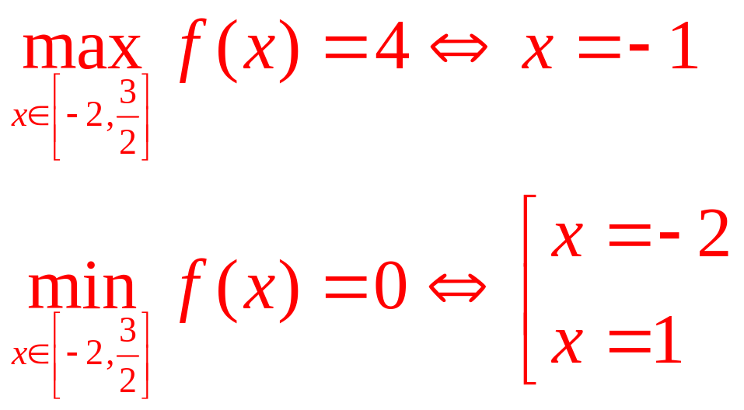
Using Derivatives to Find Absolute Maximum and Minimum Values
Example 1 (concluded):
2012 Pearson Education, Inc. All rights reserved
Slide 2.4-<number>

Slide 24
Select the correct ones.
If f’(c)=0 then f has the local maximum or minimum at c.
If f has the absolute minimum value at c then f’(c)=0.
If f is continuous on (a,b) then f attains an absolute maximum value
f(c) and an absolute minimum value f(d) for some c and d in (a,b).
d. All of the above.
e. None of the above.
Answer: e

Slide 25
APPLICATIONS OF DIFFERENTIATION
3.2
The Mean Value Theorem
In this section, we will learn about:
The significance of the mean value theorem.
Notes:
Rolle’s theorem – what it says and when it is applicable.
The mean value theorem – what it says and when it is applicable.
How to obtain information about a function from its derivative.

Slide 26
ROLLE’S THEOREM
Let f be a function that satisfies the following three hypotheses:
  f is continuous on the closed interval [a, b]
  f is differentiable on the opened interval (a, b)
  f(a) = f(b)
Then, there is a number c in (a, b) such that f’(c) = 0.

Slide 27
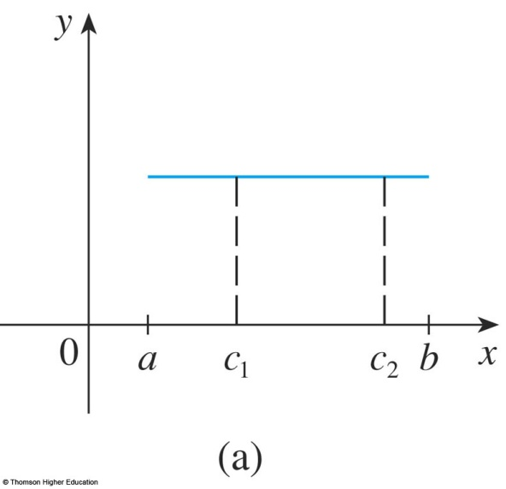
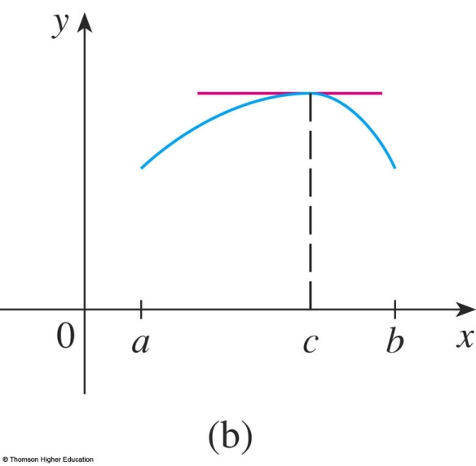
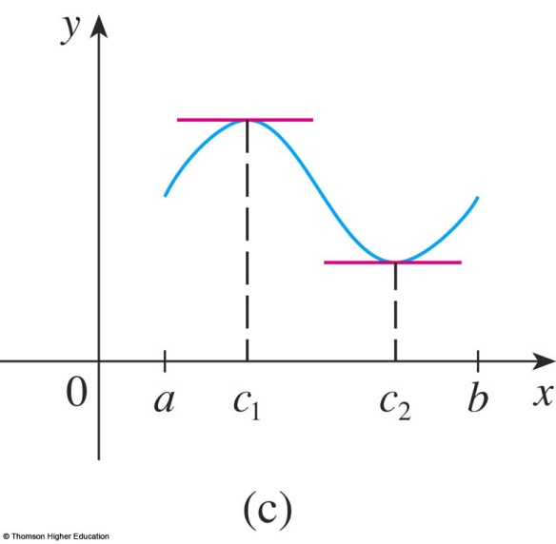
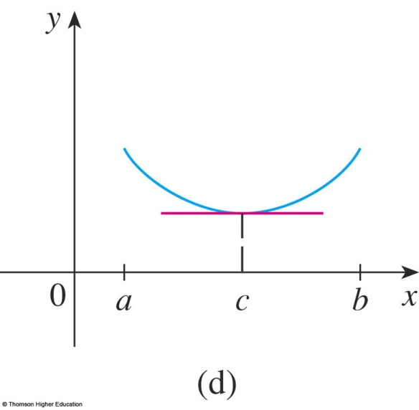
ROLLE’S THEOREM
The figures show
the graphs of
four such functions.

Slide 28
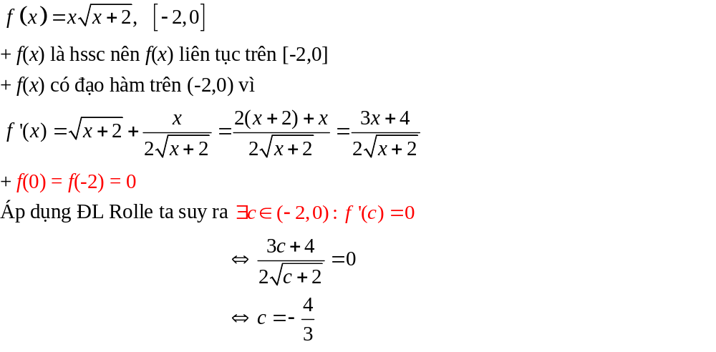

Slide 29
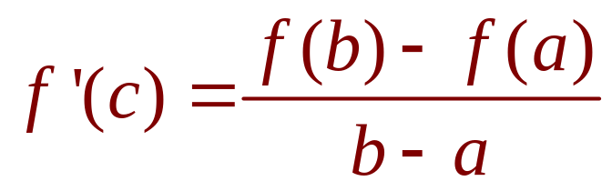
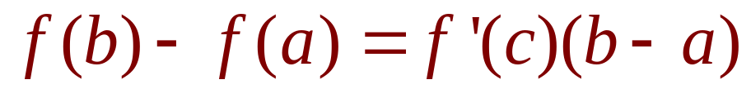
MEAN VALUE THEOREM (LAGRANGE)
Equations 1 and 2
Let f be a function that fulfills two hypotheses:
  f is continuous on the closed interval [a, b].
  f is differentiable on the open interval (a, b).
Then, there is a number c in (a, b) such that
or, equivalently,

Slide 30
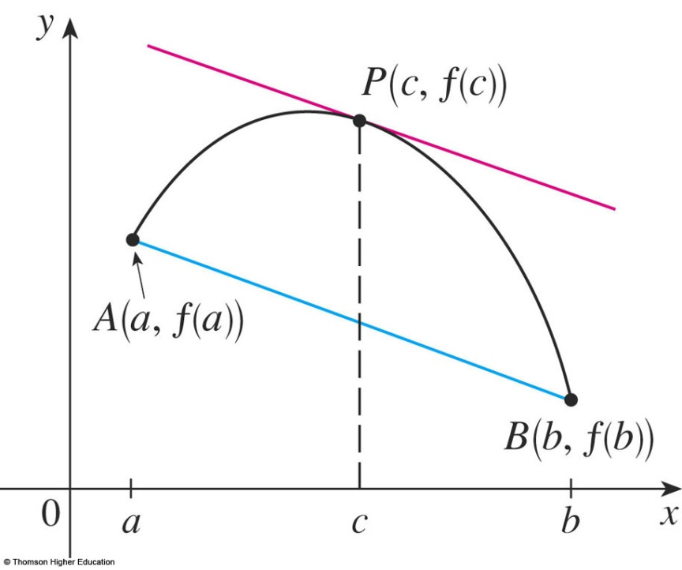
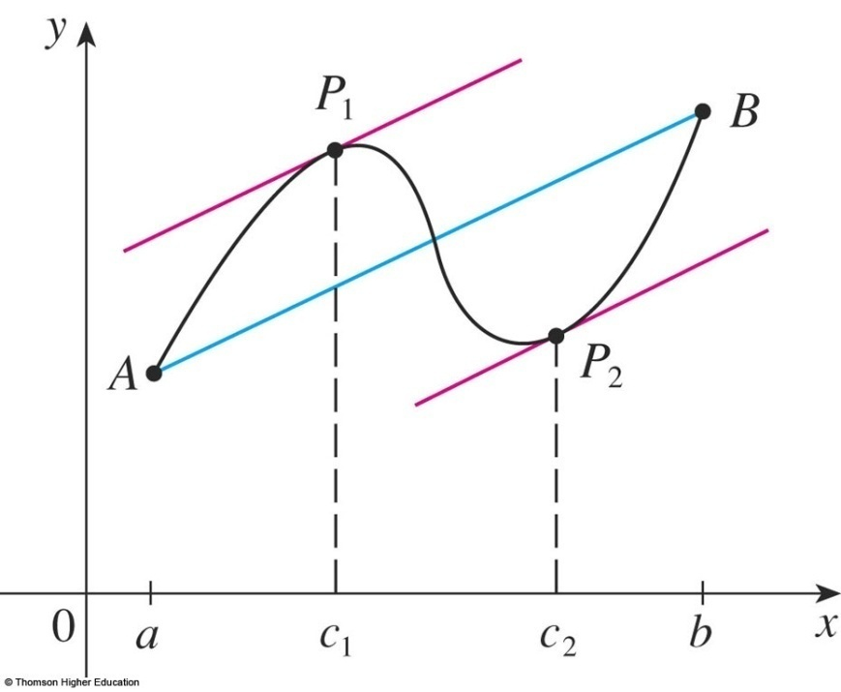
MEAN VALUE THEOREM
f ’(c) is the slope of the tangent line at (c, f(c)).
  There is at least one point P(c, f(c)) on the graph where the slope of the tangent line is the same as the slope of the secant line AB.

Slide 31
Example 5
Suppose that f(0) = -3 and f '(x) ≤ 5 for all values of x.
  How large can f(2) possibly be?
We are given that f is differentiable - and therefore continuous - everywhere.
In particular, we can apply the Mean Value Theorem on the interval [0, 2].
  There exists a number c such that
  f(2) – f(0) = f ’(c)(2 – 0)
  So, f(2) = – 3 + 2 f ’(c)

Slide 32
Example 5
  We are given that f ’(x) ≤ 5 ,∀x
  ⇒ f ’(c) ≤ 5.
  ⇒ 2 f ’(c) ≤ 10.
  ⇒ f(2) = – 3 + 2 f ’(c) ≤ – 3 + 10 = 7
  The largest possible value for f(2) is 7.

Slide 33
MEAN VALUE THEOREM
Theorem 5
If f ’(x) = 0 for all x in an interval (a, b),
then f is constant on (a, b).

Slide 34
MEAN VALUE THEOREM
Corollary 7
If f ’(x) = g’(x) for all x in an interval (a, b),
then f – g is constant on (a, b).
That is, f(x) = g(x) + c where c is a constant.

Slide 35
APPLICATIONS OF DIFFERENTIATION
3.3
Derivatives and
the Shapes of Graphs
In this section, we will learn:
How the derivative of a function gives us the direction
in which the curve proceeds at each point.
Notes:
The use of the first derivative to determine whether a function is increasing or decreasing.
The first and second derivative tests for local maxima and minima.
The use of the second derivative to determine concavity and points of inflection.
The geometric description of concavity, the relationship between concavity and the behavior of the first derivative.

Slide 36
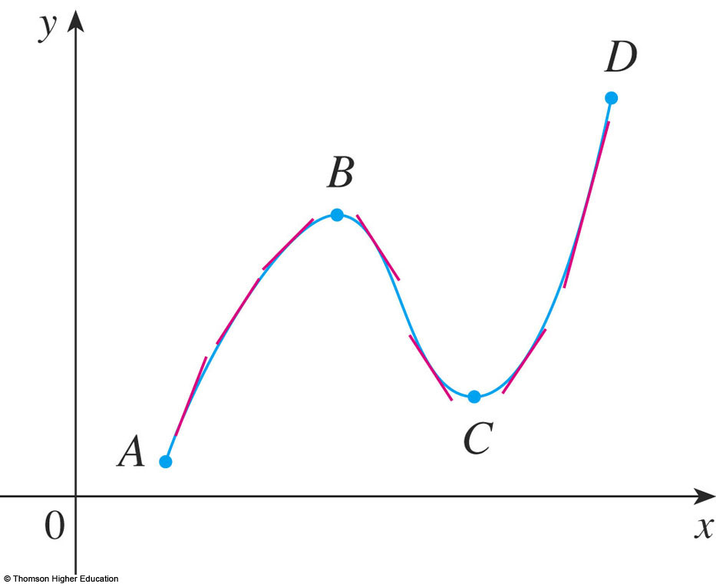
INCREASING/DECREASING TEST (I/D TEST)
If f’(x) > 0 on an interval (a,b), then f is increasing
on that interval.
If f’(x) < 0 on an interval (a,b), then f is decreasing on that interval.

Slide 37
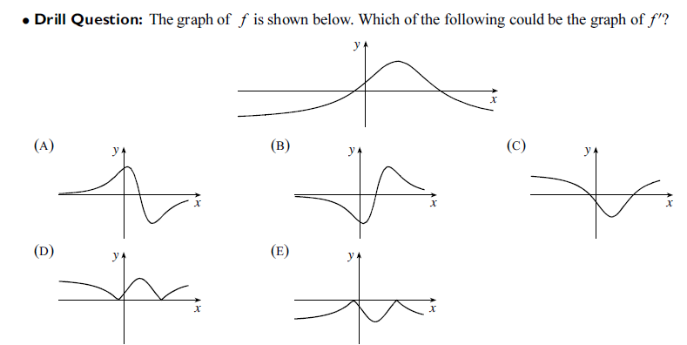
Answer: (A)
Notes:
If f(x) > 0 every x in I, the graph of its lies above x-axis.

Slide 38
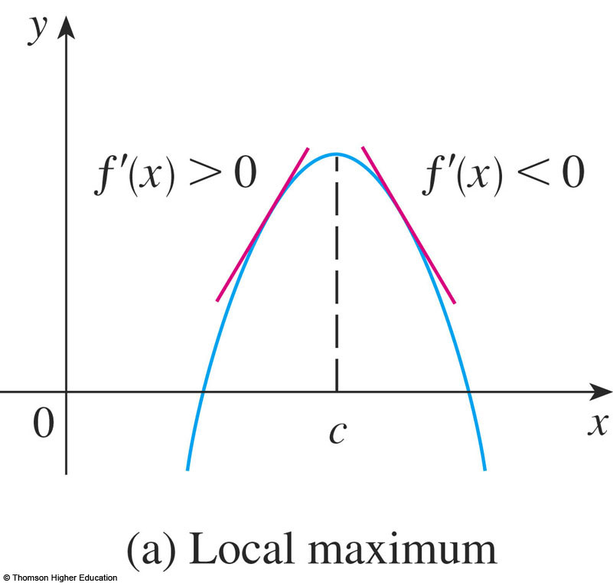
FIRST DERIVATIVE TEST
Suppose that c is a critical number of a continuous
function f.
If f’ changes from positive to negative at c, then f has a local maximum at c.
Notes:
For example y = -x²

Slide 39
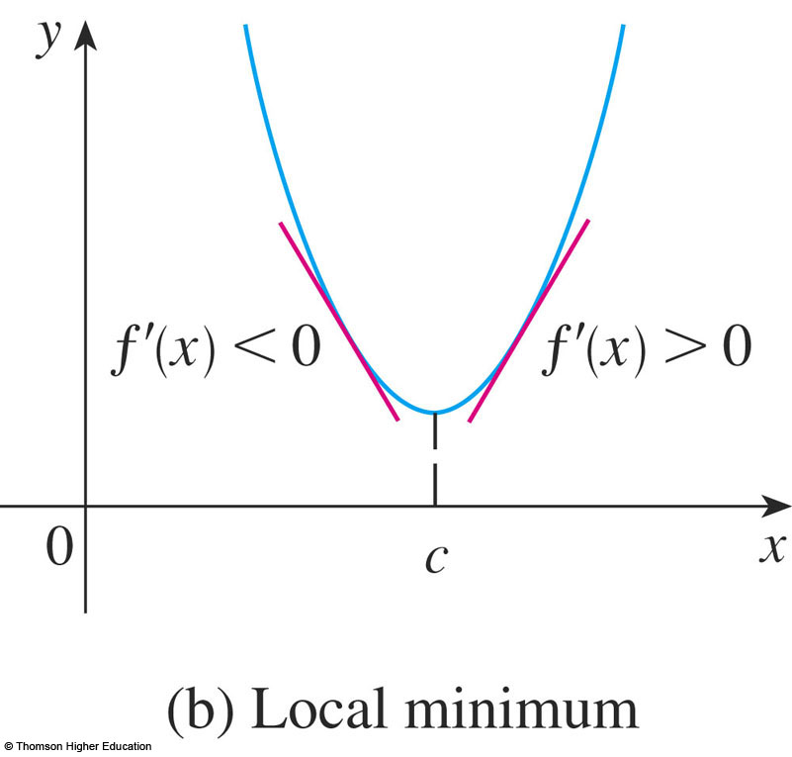
FIRST DERIVATIVE TEST
b. If f’ changes from negative to positive at c,
then f has a local minimum at c.
Notes:
For example y=x²

Slide 40
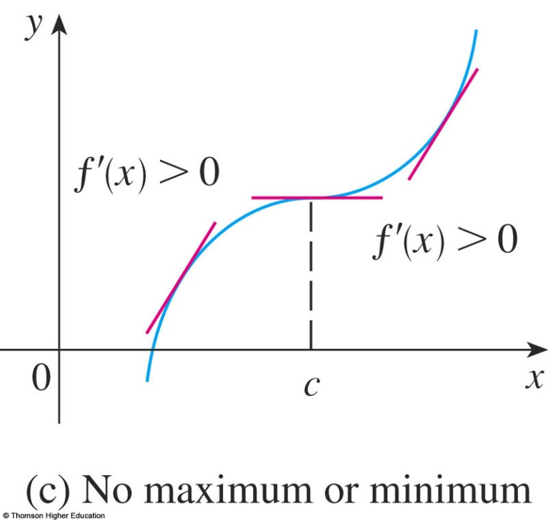
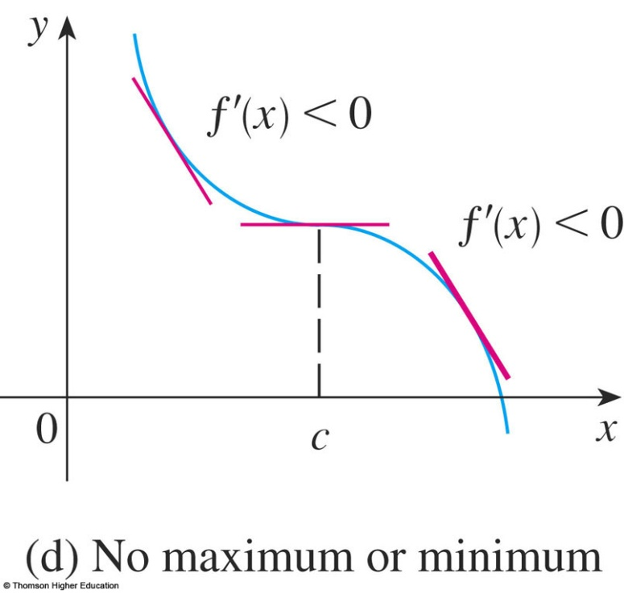
FIRST DERIVATIVE TEST
c. If f’ does not change sign at c
then f has no local maximum or minimum at c.
Notes:
For example y=x³ ; y = -x³

Slide 41
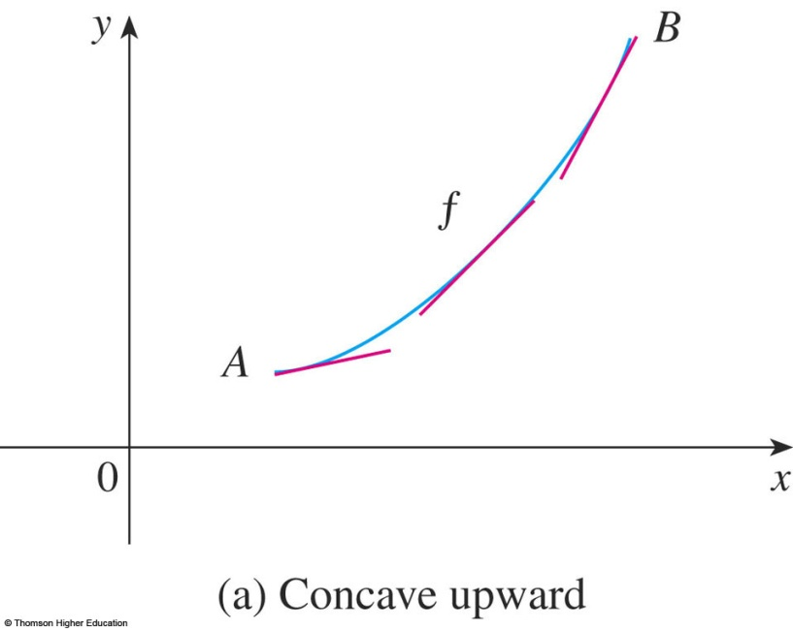
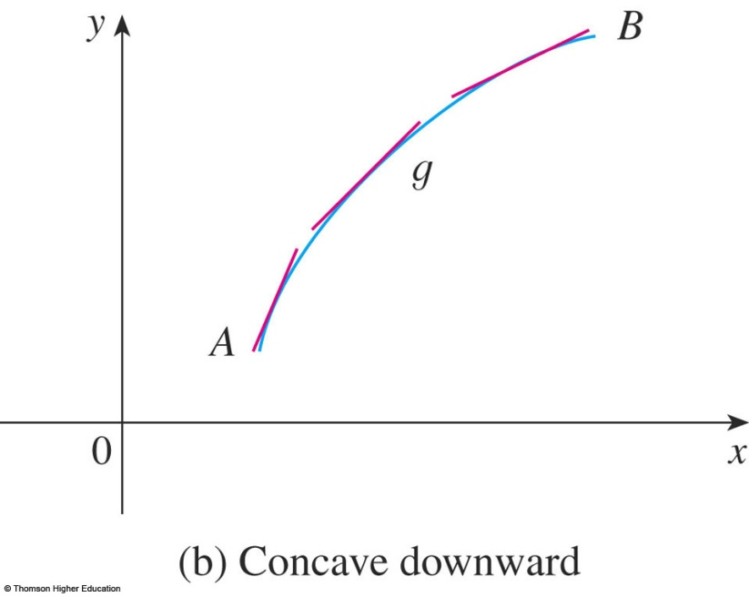
CONCAVE UPWARD/DOWNDWARD
  The curve lies above the tangents and f is called concave upward (lõm lên) on (a, b).
  The curve lies below the tangents and g is called concave downward (lõm xuống) on (a, b).

Slide 42
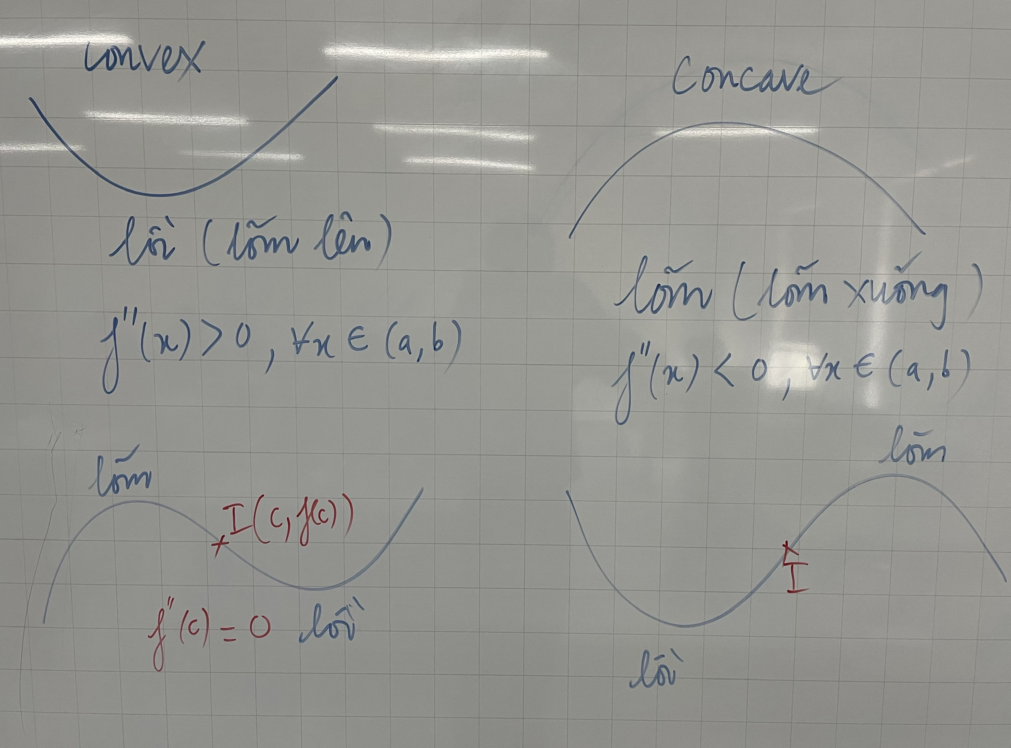

Slide 43
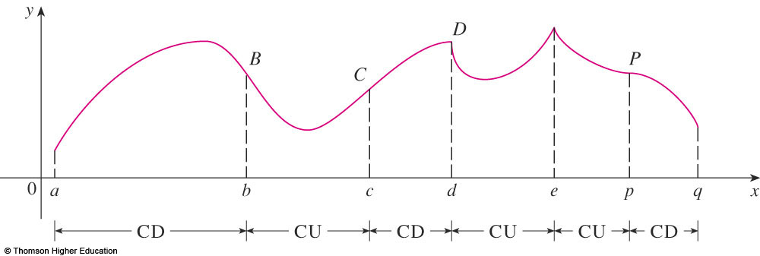
CONCAVITY TEST
If f’’(x) > 0 for all x in I, then the graph of f is concave upward on I.
If f’’(x) < 0 for all x in I, then the graph of f is concave downward on I.

Slide 44
INFLECTION POINT—DEFINITION
A point P on a curve y = f(x) is called an inflection point (điểm uốn)
if f is continuous there and the curve changes
from concave upward to concave downward
(or from concave downward to concave upward at P).
Notes:
f’’(x) =0 does not imply that (x,f(x)) is an inflection point of f.
f’’ changes from positive to negative or f’’ changes from negative to positive at a value that f’’ = 0.

Slide 45
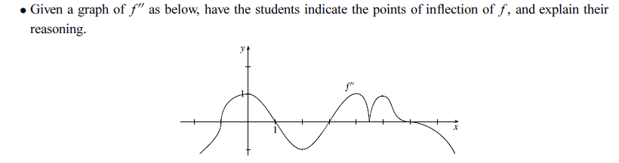
Answer: (-1,f(-1)),(1,f(1)),(3,f(3)),(6,f(6))

Slide 46
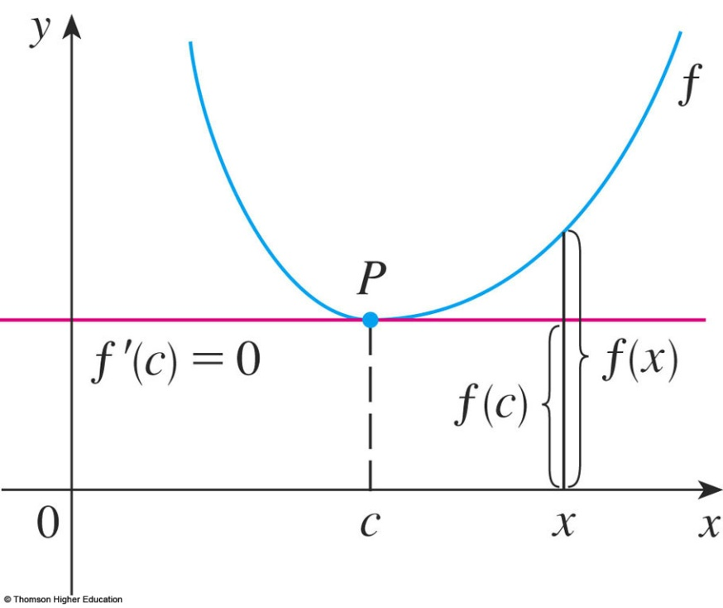
SECOND DERIVATIVE TEST
Suppose f’’ is continuous near c.
If f’(c) = 0 and f’’(c) > 0,
then f has a local minimum at c.
If f’(c) = 0 and f’’(c) < 0,
then f has a local maximum at c.
Notes:
Compare the First and second derivative Tests, discussing the advantages and disadvantages of using each, including an example such as f(x) = x⁵ , where the second derivative test is inconclusive and pointing out that although f’(0) = 0,, there is no local extreme there.

Slide 47
Choose the correct one.
A | If f has local extreme value at c then f’(c)=0.
B | If f’(c)=0 then f has local extreme value at c.
C | If f’’(3)=0 then (3,f(3)) is an inflection point of f.
D | There exists a function such that f’(x) is nonzero for all x and f(1)=f(0).
E | None of the above
Answer: e

Slide 48
APPLICATIONS OF DIFFERENTIATION
3.5
Optimization Problems
In this section, we will learn:
How to solve problems involving
maximization and minimization of factors.
Notes:
The method given in the text for setting up and solving optimization problems.
The various tests and closed interval method for finding absolute extreme.
Various useful techniques for simplifying computations during optimization problems, such as implicit differentiation and optimizing d² instead of the distance d to avoid the square root.

Slide 49
1. UNDERSTAND THE PROBLEM
Read the problem carefully until it is clearly understood.
  What is the unknown?
  What are the given quantities?
  What are the given conditions?

Slide 50
6. FIND THE ABSOLUTE MAX./MIN. VALUE OF f
Use the methods of Sections 3.1 and 3.3 to find the absolute maximum or minimum value of f.
  In particular, if the domain of f is a closed interval,
  then the Closed Interval Method in Section 3.1
  can be used.

Slide 51
Find two positive numbers such that the sum is 24
and the product is the largest?
Find two positive numbers such that the product is 36
and the sum is the smallest?
Answer: 12,12, and 6,6

Slide 52
OPTIMIZATION PROBLEMS
Example
Find the point on the line y = 2x -3
that is closest to the origin.

Slide 53
(x,2x-3) is in the line and the distance from it to the origin is …
We find the minimum of…

Slide 54
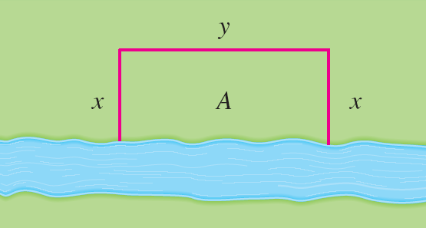
OPTIMIZATION PROBLEMS
Example 1
A farmer has 2400 ft of fencing and wants to fence off a rectangular field that borders a straight river. He needs no fence along the river.
  What are the dimensions of the field that has the largest area ?

Slide 55
OPTIMIZATION PROBLEMS
Example 1
This figure illustrates
the general case.
We wish to maximize the area A of the rectangle.
  Then, we express A in terms of x and y: A = xy
  2x + y = 2400
  So, A(x) = 2400x – 2x², 0 < x < 1200
  …

Slide 56
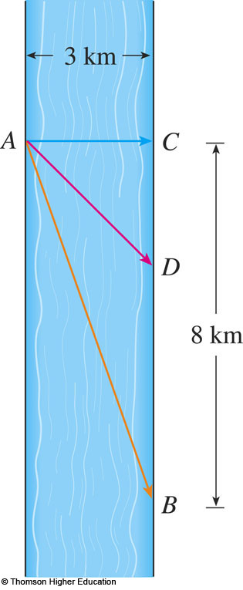
OPTIMIZATION PROBLEMS
Example 4
A man launches his boat from point A on a bank of a straight river, 3 km wide, and wants to reach point B (8 km downstream on the opposite bank) as quickly as possible.
If he can row 6 km/h and run 8 km/h, where should he land to reach B as soon as possible?
Notes:
S=vt

Slide 57
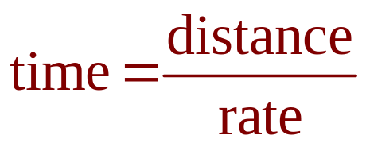
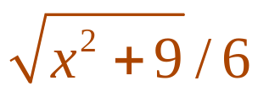
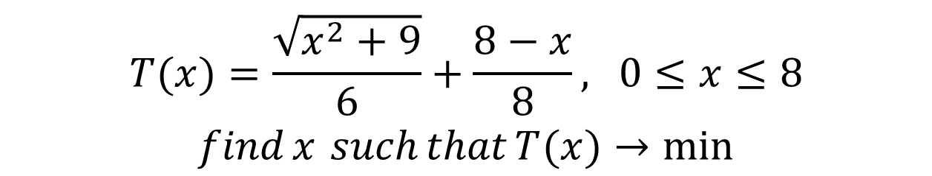
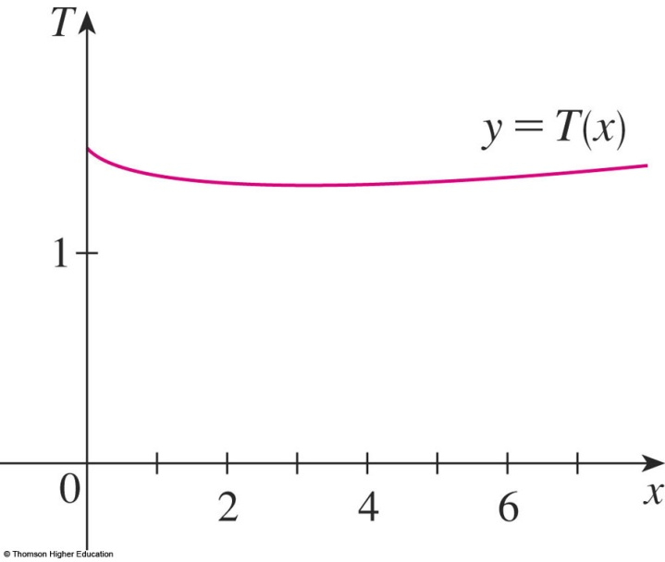
OPTIMIZATION PROBLEMS
Example 4
We use the equation:
  X = CD
  Then, the rowing time is:
  The running time is: (8 – x)/8
  So, the total time T as a function of x is:

Slide 58
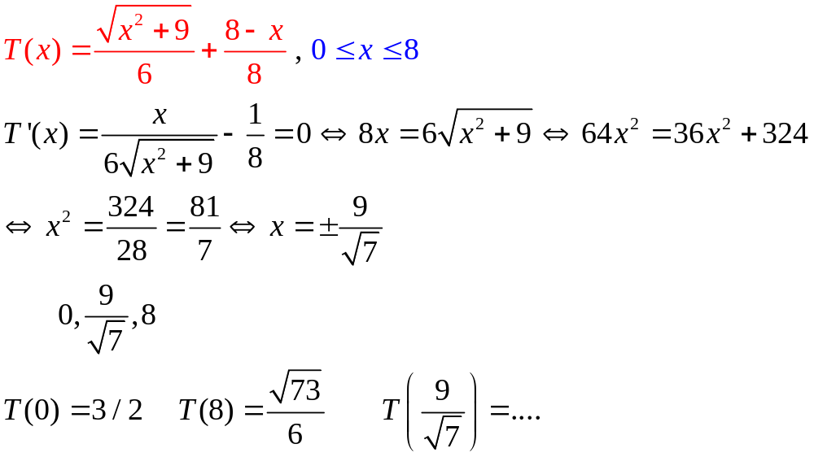
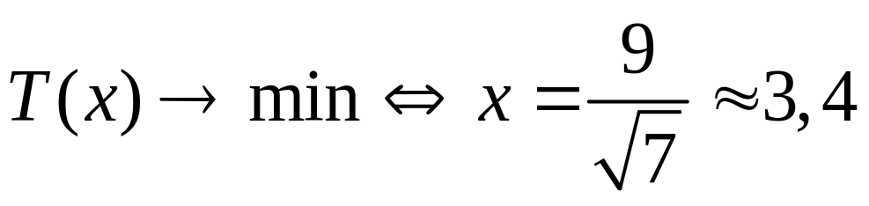

Slide 59
A rectangular storage container with an open top is to have a volume of 15 m³ The length of its base is twice the width.
Material for the base costs $10 per square meter. Material for the sides costs $6 per square meter. Find the cost of materials for the cheapest such container.

Slide 60
APPLICATIONS OF DIFFERENTIATION
3.6
Newton’s Method
In this section, we will learn:
How to solve high-degree equations
using Newton’s method.
Notes:
Newton’s method and its uses.
Geometric interpretation of Newton’s method.
The speed of approximation of Newton’s method.

Slide 61
NUMERICAL ROOTFINDERS
How do those numerical root finders work?
  They use a variety of methods.
  Most, though, make some use of Newton’s method, also called the Newton-Raphson method.

Slide 62
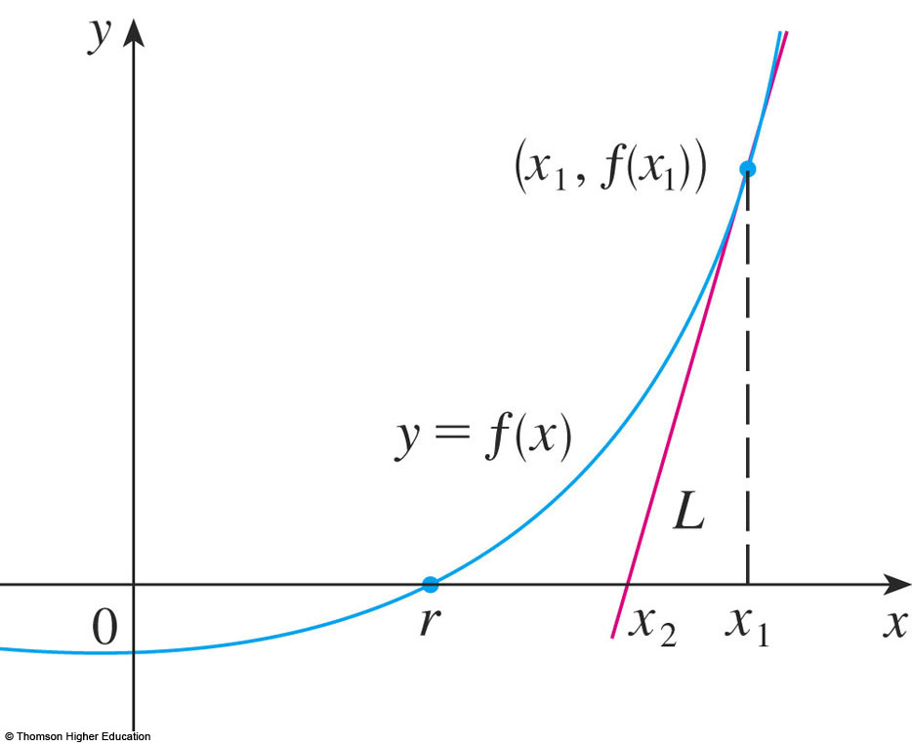
NEWTON’S METHOD
We start with a first approximation x_{1,} which is obtained by one of the following methods:
  Guessing
  A rough sketch
  of the graph of f
  A computer-
  generated graph of f
Notes:
How do you do know what to choose as x₁ ?

Slide 63
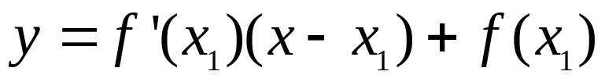
NEWTON’S METHOD
Consider the tangent line L to the curve y = f(x) at the point (x₁, f(x₁)) and look at the x-intercept of L, labeled x₂.

Slide 64
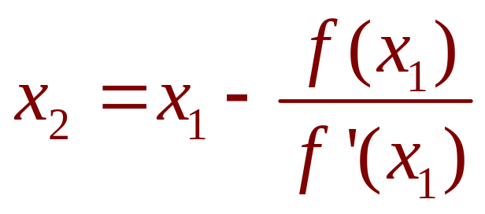
SECOND APPROXIMATION
As the x-intercept of L is x₂, we set y = 0 and obtain:
0 - f(x₁) = f’(x₁)(x₂ - x₁)
If f’(x₁) ≠ 0, we can solve this equation for x₂:
  We use x₂ as a second approximation to r.

Slide 65
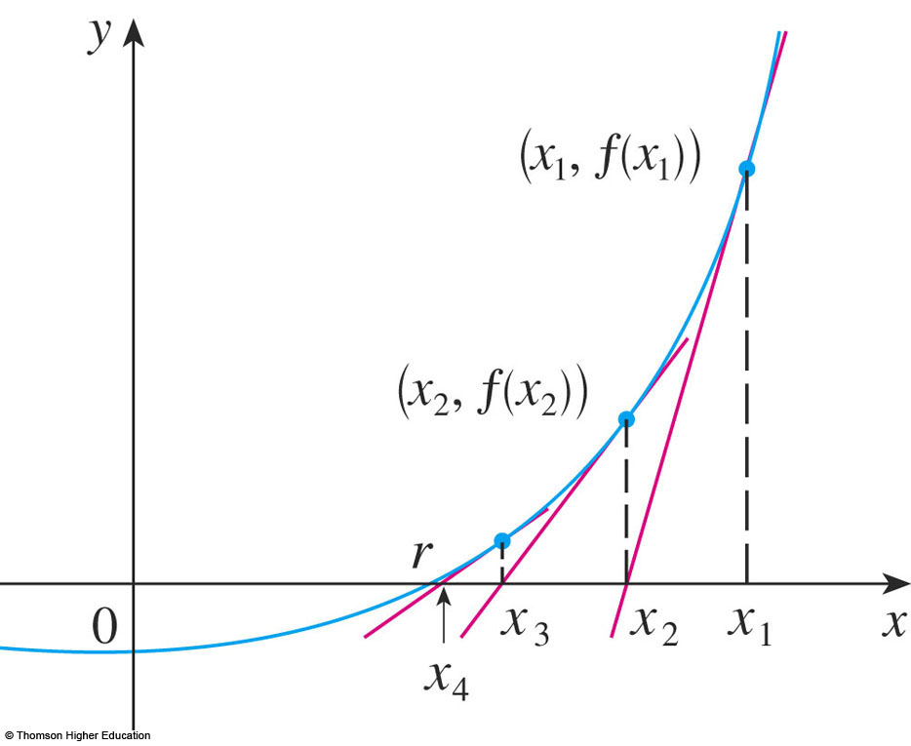
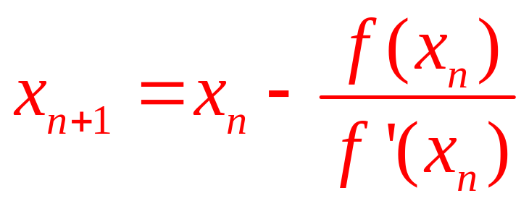
SUBSEQUENT APPROXIMATION
Equation/Formula 2
In general, if the nth approximation is x_{n} and
f’(x_{n}) ≠ 0, then the next approximation is given by:

Slide 66
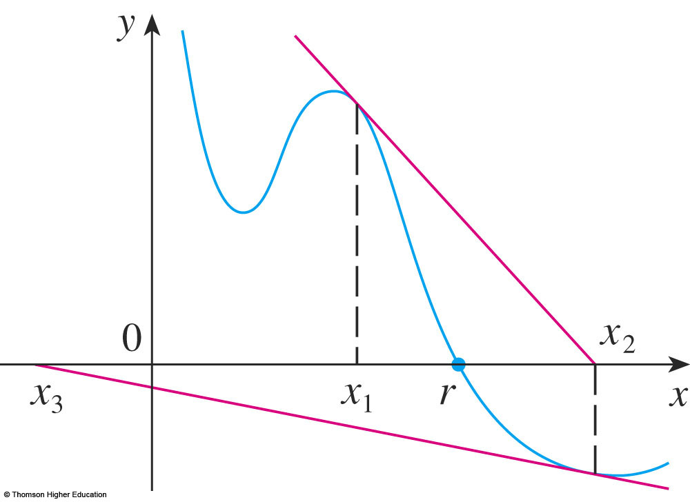
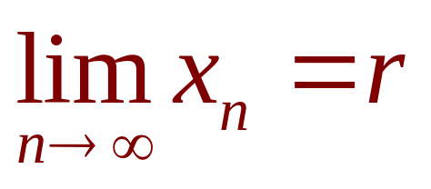

CONVERGENCE
If the numbers x_{n} become closer and closer to r as n becomes large, then we say that the sequence converges to r and we write:

Slide 67


NEWTON’S METHOD
Example 2
Use Newton’s method to find correct to eight decimal places.
  First, we observe that finding is equivalent to
  finding the positive root of the equation x⁶ – 2 = 0
  So, we take f(x) = x⁶ – 2
  Then, f’(x) = 6x⁵

Slide 68

NEWTON’S METHOD
Example 2
So, Formula 2 (Newton’s method) becomes:

Slide 69


NEWTON’S METHOD
Example 2
Choosing x₁ = 1 as the initial approximation, we obtain:
  As x₅ and x₆ agree to eight decimal places, we
  conclude that to eight decimal places.

Slide 70


Slide 71
APPLICATIONS OF DIFFERENTIATION
3.7
Antiderivatives
In this section, we will learn about:
Antiderivatives and how they are useful
in solving certain scientific problems.
Notes:
Anti derivatives with and without initial conditions.
Position, velocity and acceleration.

Slide 72
DEFINITION
A function F is called an antiderivative of f on an interval (a,b) if F’(x) = f(x) for all x in (a,b).

Slide 73
ANTIDERIVATIVES
Theorem 1
If F is an antiderivative of f on an interval (a,b),
the most general antiderivative of f on (a,b) is
F(x) + C
where C is an arbitrary constant.

Slide 74
Let f(x)=tanx, and F(x) is an antiderivative of f(x). Evaluate f
and tell whether F is increasing or decreasing at x= - 3 (rad)
Answer:

Slide 75

ANTIDERIVATIVE FORMULA
Table 2
Here, we list some particular antiderivatives.

Slide 76
RECTILINEAR MOTION
Example 6
A particle moves in a straight line and has acceleration given by a(t) = 6t + 4.
Its initial velocity is v(0) = -6 cm/s and its initial displacement is s(0) = 9 cm.
  Find its position function s(t).

Slide 77
A particle moves along the x-axis so that its velocity at time t is given by 3 sin 2t.
Assuming it starts at the origin, where is it at t = π seconds?
a. 0 b. 3/2 c. ½ d. - 1/2
Answer: a

Slide 78
Let f(x)=4-3x for all x>=2. Select the correct one.
2 is the local minimum value.
2 is the local maximum value.
-2 is the local minimum value.
-2 is the maximum local value.
2 is the absolute minimum value.
-2 is the absolute maximum value.
None of the above.
Answer: f

Slide 79
A piece of wire (dây kim loại) 10 m long is cut into two pieces. One piece is bent into a square and the other is bent into an equilateral triangle (tam giác đều).
How should the wire be cut for the square so that the total area (of the square and the triangle) enclosed is a minimum? Round the result to the nearest hundredth.
Answer: If x is the length of the square then
the side of the triangle is 1/3 (10-4x)
We find the minimum of x²+…

Slide 80
P. 148: 23 – 44
p. 155: 1 – 4 ; 23;
p. 162: 21 – 25
p. 176: 2 – 6 ; 16;36
p. 183: 5, 6, 9, 10
p.190: 30; 33 – 36
Thanks

